Slide 1
Python for Cyber Security
Workshop
Satria Ady Pradana
DSCNF Class #6
April 3rd, 2021

Slide 2
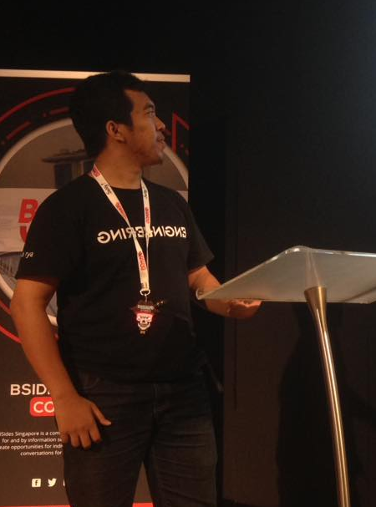



Hi!
Satria Ady Pradana
Ordinary Cyber Security Guy
Cyber Security Consultant at Mitra Integrasi Informatika
Penetration Tester, Red Team
IoT / OT Cyber Security Special Interest Group
Community Leader of Reversing.ID
Love Low-Level Stuffs
@xathrya
xathrya
xathrya

Slide 3
packet crafting
Cyber Security
reverse engineering
penetration testing
fuzzing
❤
web scraping
forensic
exploit development
machine learning
Python

Slide 4
Tools? Python!
Many essential tools are written in Python.
Many tools scriptable with Python.
Not satisfied? Write your own tools.

Slide 5
I Choose You, Python!
Python for Cyber Security
Designed for rapid prototyping
Simple and clean structure, improve readability and ease of use.
Extensive library, also ease of interfacing.
Widely adopted, most linux distros ship it by default.*
Ideal language for scripting and rapid development.

Slide 6


Python… for?
Offensive Red Team
Defensive Blue Team
Automate
6

Slide 7
Offensive Python
Engagement in before, during, and after exploitation.
Interact with target (host, service).
Setting up infrastructure.

Slide 8
Defensive Python
Detecting or hunting anomality.
Collect and parsing logs.

Slide 9
What’s here?
Key point of python.
Building block for cyber security activity.
Roll your own tools.

Slide 10
Our Setup
Kali Linux 2021.1 (VM)
Python 3.9.2
Libraries:
pycrypto / pycryptodome
requests
beautifulsoup4
scapy
Make sure you already install

Slide 11
Implementation
CPython (reference)
IronPython and FePy (run on top of .NET VM)
Jython (run on top of JVM / Java VM)
PyPy (python in python)
Many more…
See https://www.python.org/download/alternatives/

Slide 12
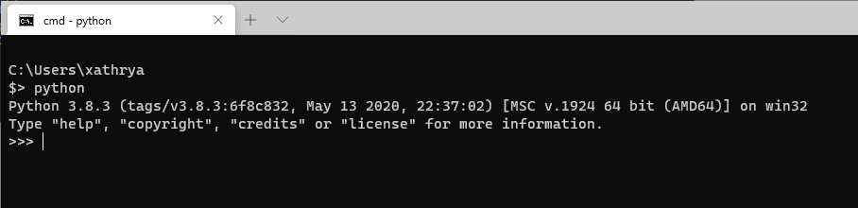
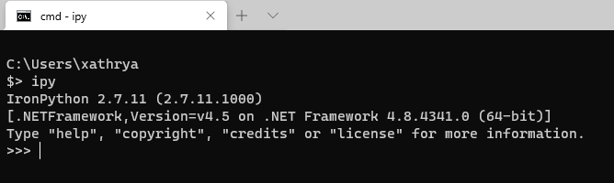
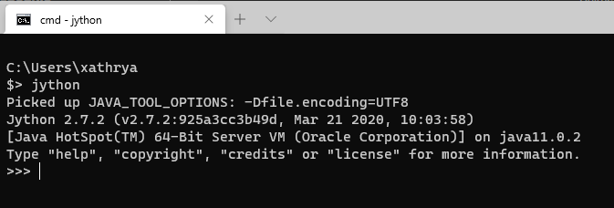

Slide 13
References
Pythonidae Challenge (https://github.com/MII-CyberSec/Pythonidae-Challenge)
Python-Assisted Red-Team Operation (https://www.slideshare.net/xathrya/pythonassisted-redteaming-operation)

